Slide 1
Installation Git

Slide 2
Installation git
Git comes installed by default on most Mac and Linux machines!
For Windows git can be download from https://git-scm.com/download/win

Slide 3
Essential Commands
While using git command it’s required to use keyword git before actual command as follows.
git command_to_run <optional argument>
init - init command used to initiate/create a git repository to current directory/folder, it could be in local or remote environment.
Syntax- git init
remote – it is use to connect current local repository with a remote git repository.
Syntax - git remote add origin <git_repository_url>
config: to communicate with remote git repository, config command is used to set default username and email
Syntax: (a)to set username:
git config --global user.name "FIRST_NAME LAST_NAME“
(b) To set email address:
git config --global user.email MY_NAME@example.com
(c) to check existing configuration
git config --list

Slide 4
Essential Commands
clone – clone command used for get copy of a remotely located git repository or branch of a remote git repository,
Syntax – (a) to get copy entire repository
git clone <url_of_remote_repository>
log – Git log is a utility tool to review and read a history of everything that happens to a repository. Multiple options can be used with a git log to make history more specific. Generally, the git log is a record of commits
Syntax – git log

Slide 5
(b) to get copy of a branch from remote repository
git clone -b <branch_name> <url_of_remote_repository >
status – status command show details of files in which change made from last update
Syntax – git status
add – add command add selected or all updated files to in queue to
Syntax – (a) To add a specific updated file
git add <file_name>
(b) To add all updated files
git add .
commit – commit command used for get ready changes from last update in local environment. Once committed changes must be push for final changes in remote repository
Syntax- commit –m “message or label to mention”
push - it is used to send file/files from one or more commits to the remote repository
Syntax- (a) To push commit/s in existing branch
git push origin <branch_name>
(b) To push commit/s in new branch
git push --set-upstream origin <new_branch_name>

Slide 6
fetch – it is used for get updates from remote repository to local environment.
Syntax – git fetch
merge - it is used for merge updates to local environment.
Syntax – git merge
pull – it is combination of fetch and merge commands.
Syntax- git pull
checkout – to switch from one branch to another checkout is used, or to create a new branch
Syntax – (a) to switch from existing branch
git checkout <branch_name>
(b) to create another branch
git checkout –b <new_branch_name>

Slide 7
Advanced Commands
restore - this command is used to discard changes made after last update
Syntax- (a) to discard changes from a single updated file
git restore <file_name>
(b) to discard changes from all updated files
git restore .
reset – this command is used to rollback recent work from a git repository in local environment. There are separate parameters to be used for different purpose for reset work in git.
To get back to sepecific commit from staging area after commit, without update the file.
git reset <desired_commit_hash>
(b) To remove all files from staging area after commit, without update files.
git reset
(c) To remove all files from staging area after commit, work done in all files will be removed.
git reset –hard

Slide 8
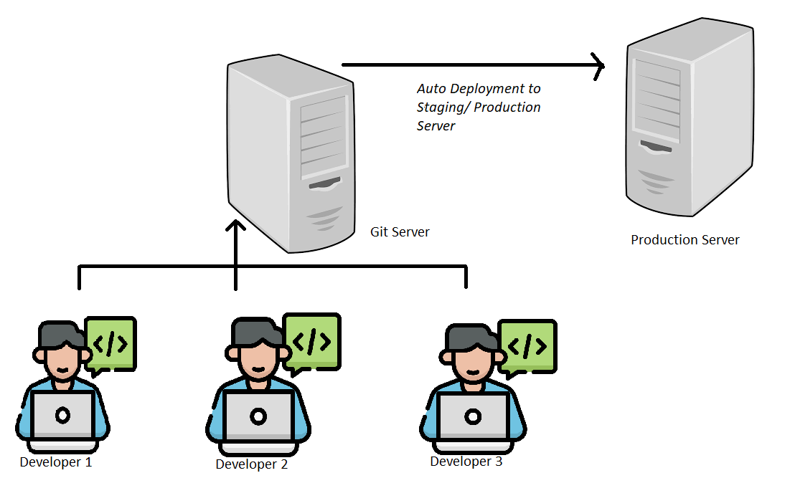
Proposed Git at MPHC/IT Wing

Slide 9
revert - The git revert command is used for undoing changes to a repository's commit history.
Syntax – git revert <commit_hash>
clean – The Git Clean command is used to clean the untracked files in the repository. If we want to remove the unwanted files then we can use the clean command in Git. When developers want to remove the untracked files in the working repository then this command is very helpful to them.
Syntax –
(a) git clean -n: to dry run.
(b)git clean -f: forcefully file deletion.
(c) git clean -f -x: delete .gitignore files
(d) git clean -f -d: delete the untracked directories.
There are certain limitations associated which are as follows:
By default, it will not remove:
the .gitignore files
new directories which are created recently
index files.
existing commit files

Slide 10
rebase – to apply any commits of current branch ahead of specified one
Synatx - git rebase <branch_name>
Stash – this command is used for save work without commiting it for later use
Syntax – (a)Save modified and staged changes
git stash
(b) list stack-order of stashed file changes
git stash list
(c) write working from top of stash stack
git stash pop
(d) discard the changes from top of stash stack
git stash drop
Diff
Ls-files - Show information about files in the index and the working tree
Syntax – git ls-files

